Slide 1
Title Slide
Strategy for Learning 2030
Consultation presentation

Slide 2



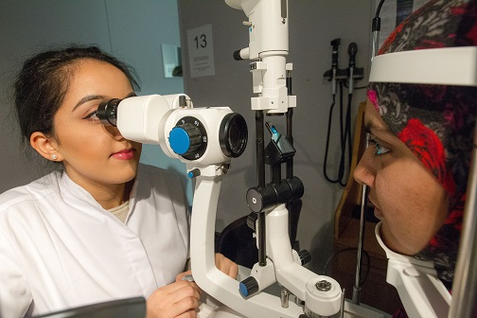


Images of future technologies

Slide 3
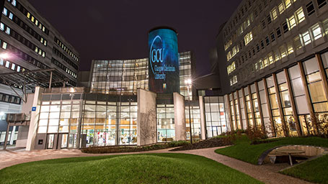
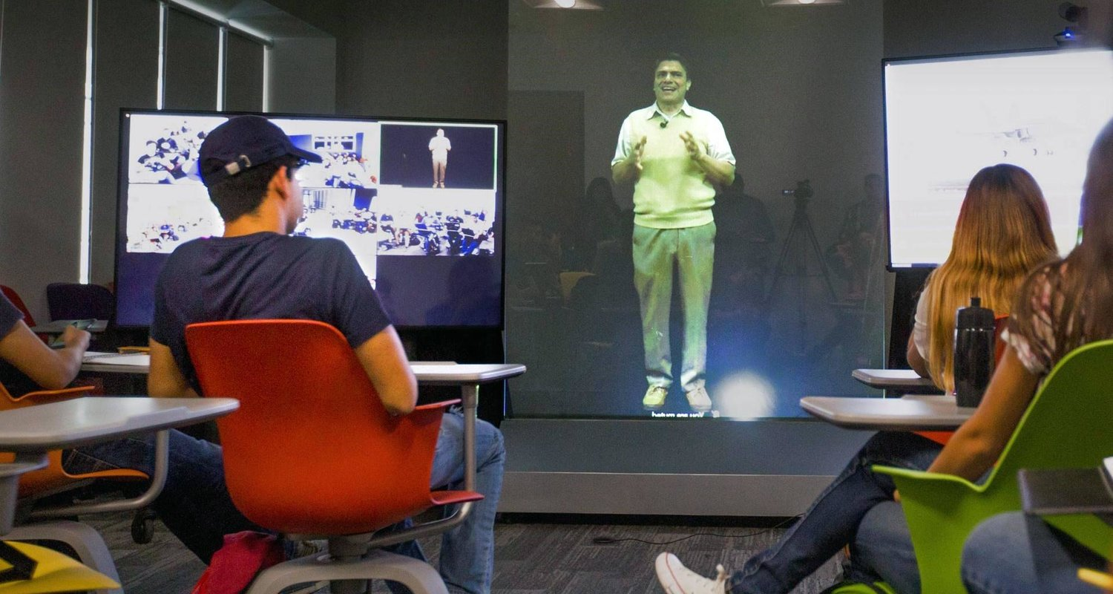

Images of future technologies
GCU in 2030- what will the University look like?
Notes:
Blended student experience
Mix of on campus/ physical face to face and online
Growth in online only provision- attractive for international and work based learners/ apprenticeships etc.
Diversify our offer and student body
Wider range of qualifications/ awards
New tech- new opportunities/ changing role of academic staff.

Slide 4


Our Offer – Pedagogical Transformation
Connected, Responsive Curriculum
Research/ Practice led & Evidence based
Technology facilitated
Active & Collaborative learning
Flexible, Personalised, Step on Step Off
On and off campus
Classroom, simulated, Real world & Virtual
Common Good Curriculum

Slide 5
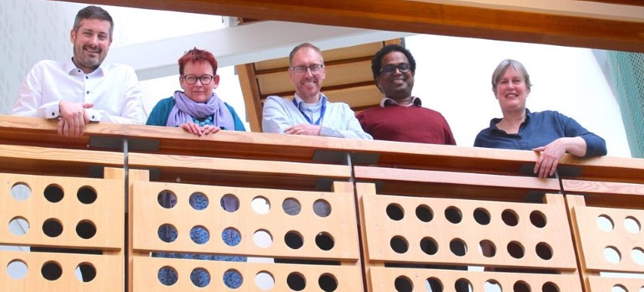
Our staff
Academic Role & Changing Pedagogies
Rapid developments in Technology
Building learning communities
Learners expectations & Support needs
Ongoing culture of innovation
Evolving Staff development needs
Resilience & Well being
Evolving challenges
Notes:
Changing nature of academia

Slide 6
Achieving our goals- L and T Strategy 2030
Transformative Education
Pedagogic Approach
2030 Intentions
Delivery Actions
Graduate Outcomes
Transformative Education- our primary goal
Pedagogic Approach- principles, latest research, SDG Goals, inclusivity
Our intentions- where do we want to be by 2030
Delivery actions- required to achieve our intentions
Graduate outcomes- revised Common Good Attributes, employability…

Slide 7
Graduate Outcomes
Common Good Attributes for Sustainability
1. Entrepeneurial Mindset
4. Active global citizenship
5. Responsible Leadership
6. Digital literacy
2. Compassion
3. Wellbeing and resilience
To replace and extend GCU’s current 4 Common Good Attributes (active and global citizenship, confidence, entrepreneurial mind-set and responsible leadership).
Underpinned by the University’s four core values (Integrity, Creativity, Responsibility and Confidence).

Slide 8
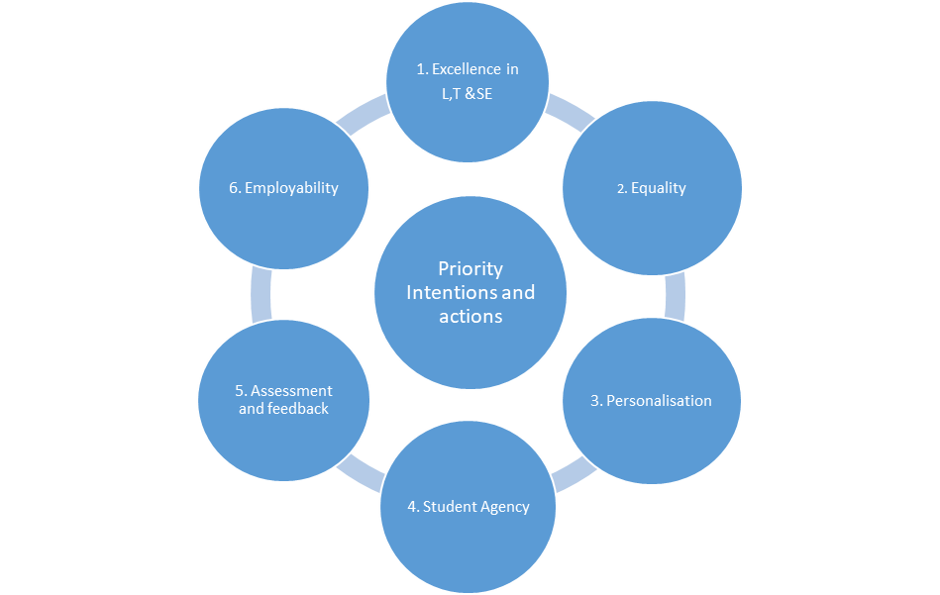
Delivering our new L&T strategy: priority intentions and actions
Excellence in L, T and student experience
Equality of participation and attainment for all students
Greater personalisation of the student experience
Student Agency
Enhancing Assessment and Feedback
Employability

Slide 9
Indicators of Success: KPIs +
Overall Strategy 2030, Transformative Education
SIMD20 intake- 20%
SIMD20 retention- 90%+
NSS- %age of subjects in the upper quartile, 50%+
Degree completion, 80%+
Graduate Outcomes- highly skilled employment- at least sector average
Additional?
All staff who teach/ support student learning have appropriate national professional recognition
Enhanced performance in Ref 2027 Education unit of assessment
Increase in staff confidence and capability around learning technologies
Successful ELIR, PSRB accreditation , national equality chartermarks etc
Increase in staff and student wellbeing
Others?

