Slide 1


An Introduction To
Manifesto Writing
Sara MacLean
Deputy Returning Officer

Slide 2
Welcome
In this training session we will be covering…
1
2
3
Manifestos & Their Role In Elections
Manifesto Writing
Process
Manifesto Writing
Tools
Notes:
Todays training session is split in to three sections….
In the first section we will cover manifestos and their role within elections, including in GCU Students’ Association Full Time Officer Elections.
In the second section we will cover the two stages of the manifesto writing processing.
In the third and final section we will cover four tools that you can use during the manifesto process.
Overall the aim of today’s training is to help you write your manifesto/ manifestos that you will use in the election.

Slide 3

Manifestos & Their Role In Elections
What is a Manifesto?
A manifesto is public declaration of policy and aims.
The word manifesto comes from the Latin word manifestare, which roughly translated means
to show or to display.
Manifestos are usually in the format of a written document, but they don’t have to be.
Manifestos are used in representative elections as a campaigning tool.
A campaign tool is any technique or strategy used to try and induce another person to support the campaign you are promoting.

Slide 4
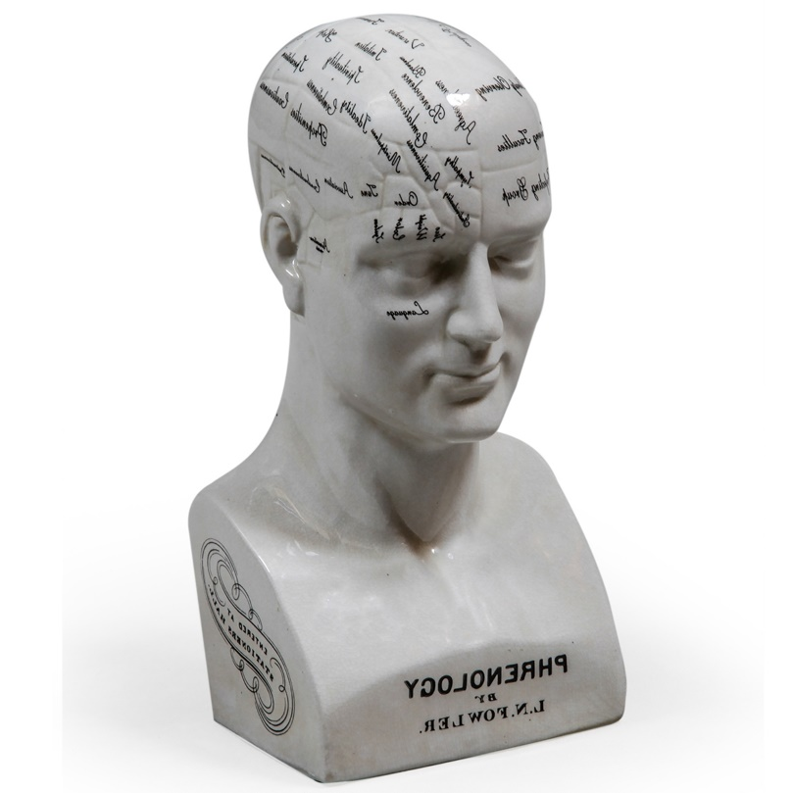
Manifestos & Their Role In Elections
Voter Psychology
The majority of voters make their decision on which candidate to vote for based upon their assessment of the policies and/ or their assessment of the person.
When it comes to appeals & arguments…
Some voters are more persuaded by logical appeals and logical arguments than emotive appeals and emotive arguments.
Some voters are more persuaded by emotive appeals and emotive arguments than logical appeals and logical arguments.

Slide 5

Manifestos & Their Role In Elections
Ballot Manifesto
[Required]
Text only.
(No images, graphics or hyperlinks)
Standardised Font.
Can contain only simple text formatting.
(Bullet points, Bold, Italics, and Underlining, Different Colours)
Can be no longer than 300 words.
(300 maximum word count)
Make sure to spell check and check grammar.
Manifestos need to be submitted by via www.gcustudents .co.uk/nominate
by Friday 21st February @ noon (12:00).
Notes:
Will be standardised in the EDIT copy, but published as given on our website
Arial
Comic sands
Courier new
Georgia
Lucida Sands
Tahomah
Times new roman
Terbuchet
Verdana
Can change manifesto until 23rd at noon. Via system only
Don’t leave to last minute it will close at 12 noon GMT no exceptions

Slide 6

Manifestos & Their Role In Elections
Manifesto Mistakes
Although there is no one right way to write/ produce a manifesto, there are four mistakes candidates in Students’ Association/ Students’ Union elections often make when writing/ producing their manifesto.
These four manifesto mistakes are…
Not being authentic!
Not asking the reader to vote for them!
Not letting the reader know when and how to vote for them!
Not integrating their manifesto into their over all campaign plan!

Slide 7

The Manifesto Writing Process
The manifesto writing process is a three stage process.
The first stage of the manifesto writing process is planning and preparation.
The second stage of the manifesto writing process is drafting and designing.
The third stage of the manifesto writing process is reviewing and revising.
At each stage of the manifesto writing process you should look to get feedback from others.

Slide 8

The Manifesto Writing Process
Planning & Preparation
Before you try to draft and design your manifesto you first need to identify your …
Goal(s)
Message(s)
Audience(s)
Your
Goal(s)
Needs to link to…
Your
Message(s)
Needs to link to…
Your
Audience(s)
What do
you want to
achieve?
What are you going to say to advance your goal(s)?
Who will connect with your message? /
Who are you trying to
connect with?
Needs to link back to…
Needs to link back to…
Notes:
5 mins to fill in sheet
5 mins to chat about It
Come up with points for manifest

Slide 9

The Manifesto Writing Process
Drafting & Designing
The next stage of the manifesto writing process is to draft and design your manifesto.
In order to draft and design you manifesto will first need to convert your message(s) into a series of policy pledges and/ or story statements.
A policy pledge is a section of text in a manifesto that outlines to the reader an action that you promise to do if elected.
A story statement is a section of text in a manifesto that outlines a personal attribute(s) that is desirable to the reader.
Policy pledges and story statements should be kept as short and simple as possible.
Notes:
What is your headline? How do plan on achieving the goal
What qualities do you have that will make you a good candidate?

Slide 10

The Manifesto Writing Process
Once you have drafted you policy pledges and/ or story statements, the next step is to order and arrange them in an appealing and attractive way that makes the manifesto clear and easy to read and understand.
A number of different design devices can be used make a manifesto appealing and attractive, as well as clear and easy to read and understand.
Design devices commonly used in manifestos include…
Text Formatting (Bullet Points, Bold, Italics, and Underlining)
Different Fonts & Font Sizes
Images & Graphic (Photos/ Clipart/ Diagrams)
Colour schemes & Design Themes
Slogans & Catchphrases
Questions & Exclamations

Slide 11

The Manifesto Writing Process
You don’t need a designer and/ or fancy software to draft and design your manifesto!
The following free applications/ programs can be used to draft and design professional looking manifestos…
Microsoft Word
Microsoft PowerPoint
Canva (www.canva.com)
Notes:
Ppt and canva for visual word for text nom form

Slide 12

The Manifesto Writing Process
Reviewing & Revising
Once you have drafted and designed your manifesto, the next and final stage of the manifesto writing process is review and revise it before submitting/ publishing it.
The purpose of reviewing and revising your manifesto is to ensure that it…
Is within any word count and/ or document specification limits
Contains no spelling and grammar mistakes
Contains no incorrect dates and times, or broken hyperlinks, or incorrect internet and email addresses
Notes:
300 words maximum. Only 300 words will be uploaded

Slide 13

The Manifesto Writing Process
The simplest way to review and revise any document, including a manifesto, is to use the Review & Revise Cycle.
Suggested revisions…
Review
Document
Revise
Document
Ask to review…
In order to properly review and revise your manifesto you really need at least two other people that you trust to read through and check it.

Slide 14

The Manifesto Writing Tools
We have a number of different tools on our Candidates Resources page to help you through the manifesto writing process.
To help you through the planning and preparation stage of the manifesto writing process we have the following tools:
S.M.A.R.T Objectives Worksheet
S.W.O.T Analysis Worksheet
To help you through the drafting and designing stage of the manifesto writing process we have the following tools:
Eight Manifesto Writing Tips
Simple Manifesto Template
Notes:
Worksheet
Identify the type of approaches you will need to take. How do you plan to defend your manifesto point without arguing

Slide 15
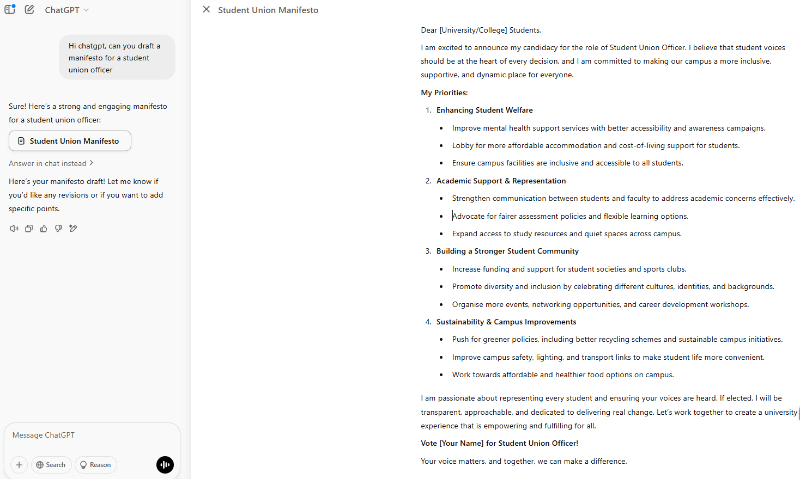
The Manifesto Writing Tools
Another tool that can be useful is AI.
Notes:
That’s not to say to get AI to write it for you but it can be used as helpful tool to get you started.

Slide 16
Manifesto Deadline Reminder
The Ballot Manifesto (required) need to be submitted to www.gcustudents.co.uk/nominate by Friday 21st February @ noon (12:00)!
If you have any questions or queries about the election rules for manifestos please get in touch with the election’s Deputy Returning Officer, Sara MacLean, via sara.maclean@gcu.ac.uk
You can find a copy of the slides and the resources for this workshop online at www.gcustudents.co.uk/candidateresources

Slide 17
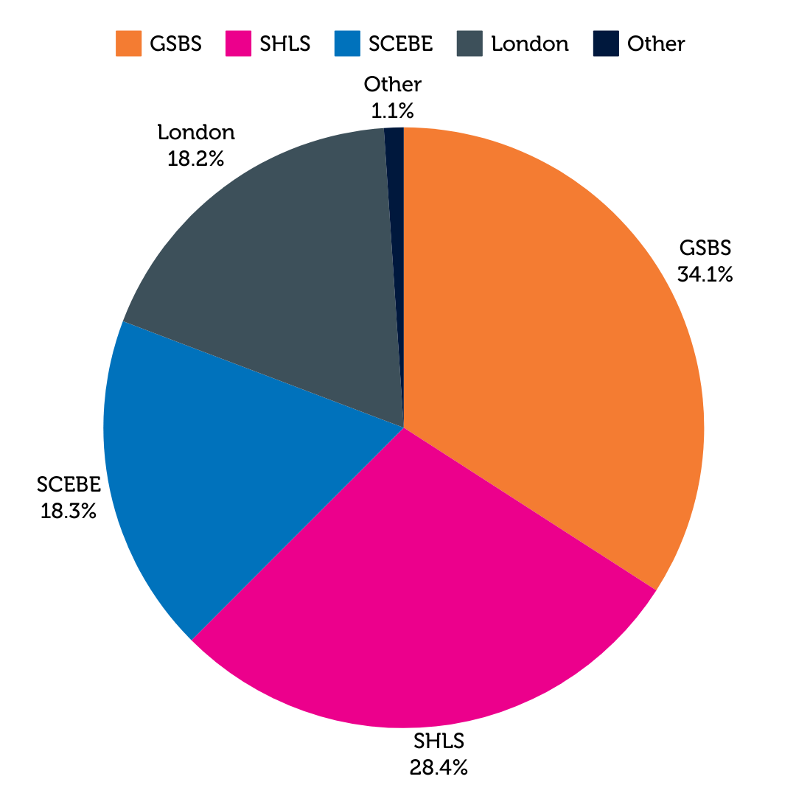

Slide 18
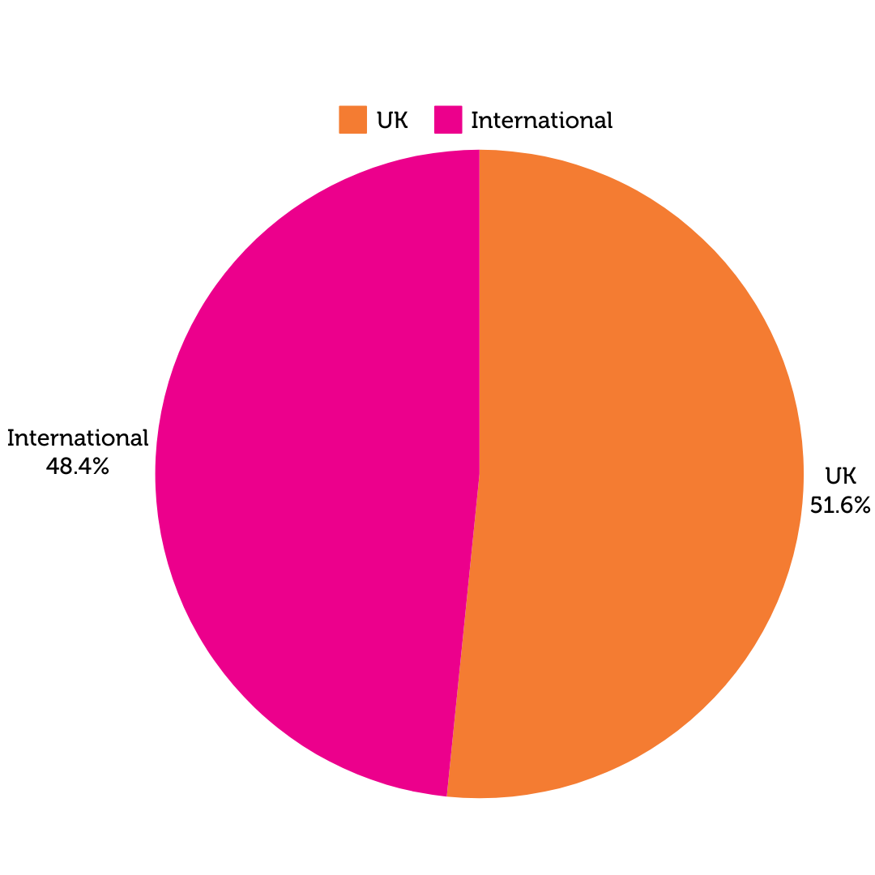

Slide 19
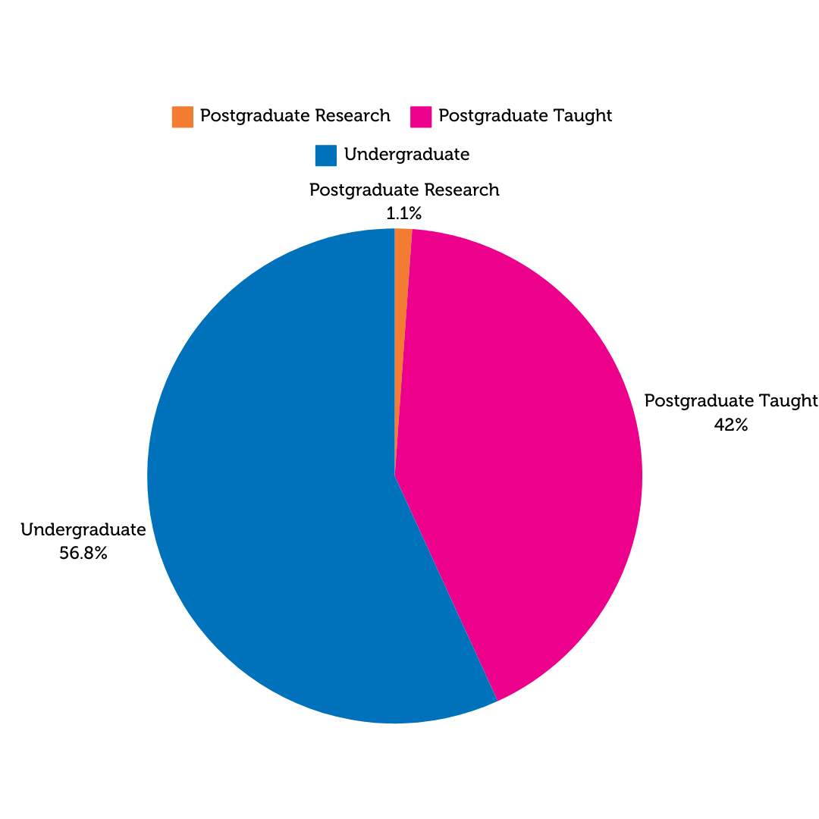

Slide 20
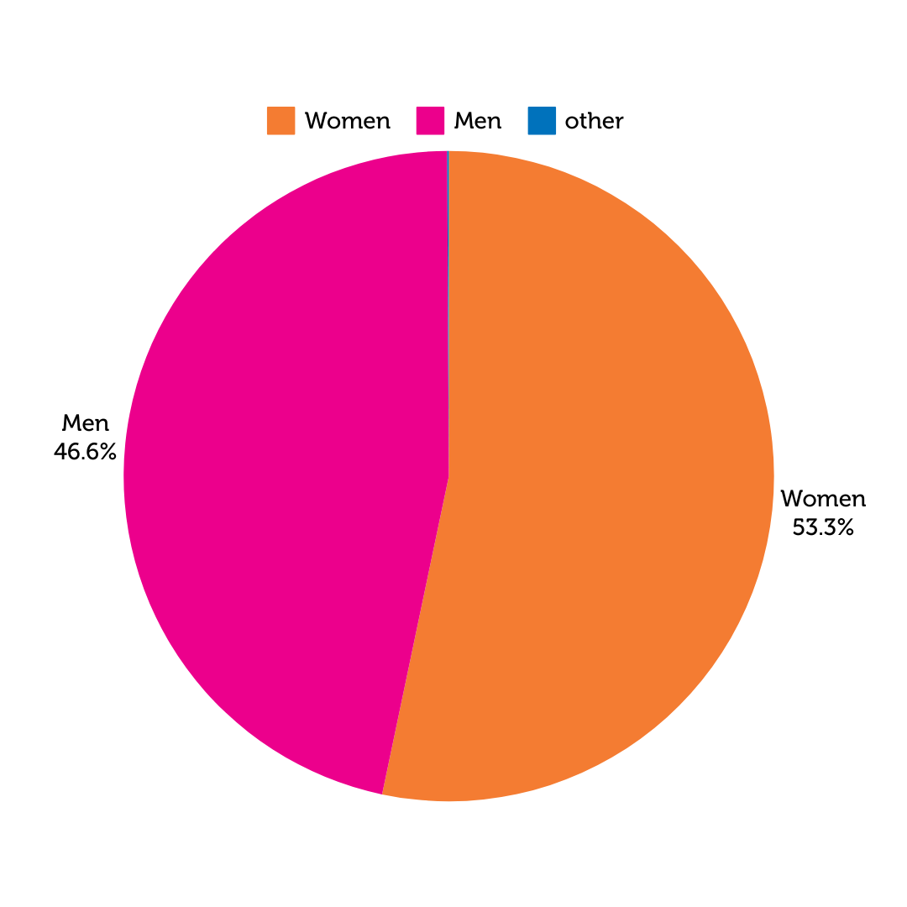
Other Demographics Trends to Note
More women than men at GCU
Primarily commuter students
Increasing numbers declaring a disability
Students on placements

Slide 21
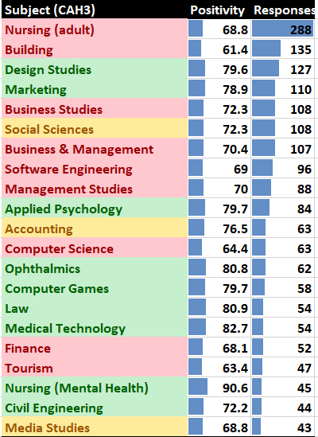
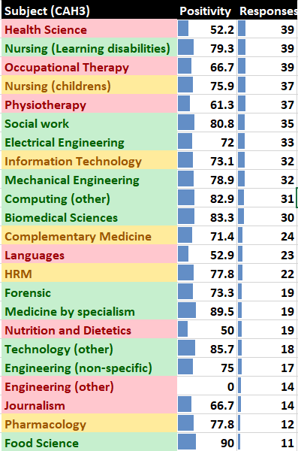
National Student Survey (UG 4th years) perception of the Students’ Association (2024)

