Slide 1
Introduction to the Students’ Association
Full Time Officer Elections
2022

Slide 2
Session Objectives
By the end of this session participants will be able to:
Detail the Students’ Association Vision, Mission and Values
Outline the Students’ Association strategic plan
List the Students’ Association services and activities
Outline the demographics of students at GCU

Slide 3
Overview of GCU Students’ Association

Slide 4
Mission and Vision
Vision:
Our Vision is that you will have an outstanding experience that will live with you forever.
Mission:
Our Mission is to represent and support GCU students to have the best university experience.
Notes:
Explain our vision and mission.

Slide 5
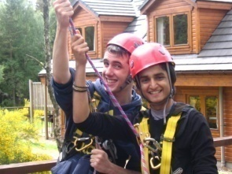
Values
Inclusive
We champion diversity and support you to be proud of who you are.
Community
We foster a culture of belonging, where you can make connections for life and by creating a supportive community.
Student-led
Our student-led activities empower students to become leaders and make their voices heard.
Fun
We are dedicated to providing a fun and friendly atmosphere where everyone is welcome.
Notes:
Explain our values
Diversity: We are proud of our diverse student body and are dedicated to activities that celebrate this diversity
Community: We foster a welcoming and inclusive environment, allowing students to form and build upon strong, lasting relationships that contribute into an enjoyable and productive University life
Participation: We promote and provide the opportunity for widespread involvement through sports, societies and volunteering in all our activities
Fun: We are dedicated and passionate about the professional nature of working for students whilst maintaining a fun and friendly atmosphere
Support: We provide a high level of consistent, reliable, confidential and independent support, ensuring the welfare of all our students
Leadership: Throughout all our activities we encourage students to become leaders, to take pride in their university and fellow students, enabling them to be outstanding graduates

Slide 6
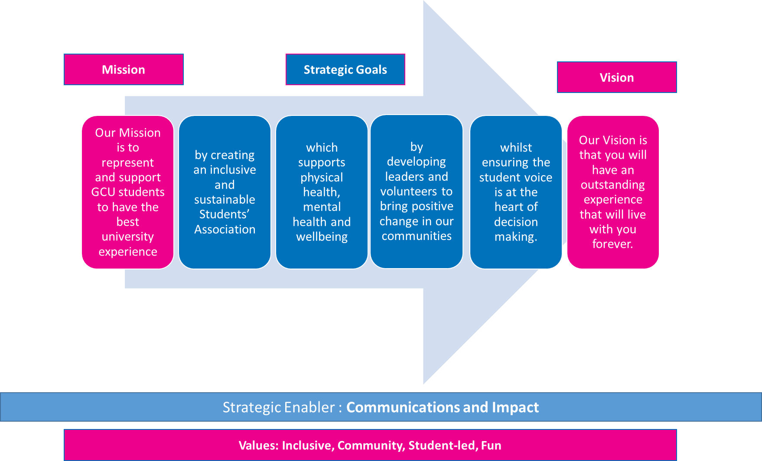
Strategic Plan 2025

Slide 7
What we are about
Creating an inclusive and sustainable Students’ Association
which supports physical health, mental health and wellbeing
by developing leaders and volunteers to bring positive change in our communities
whilst ensuring the student voice is at the heart of decision making.

Slide 8
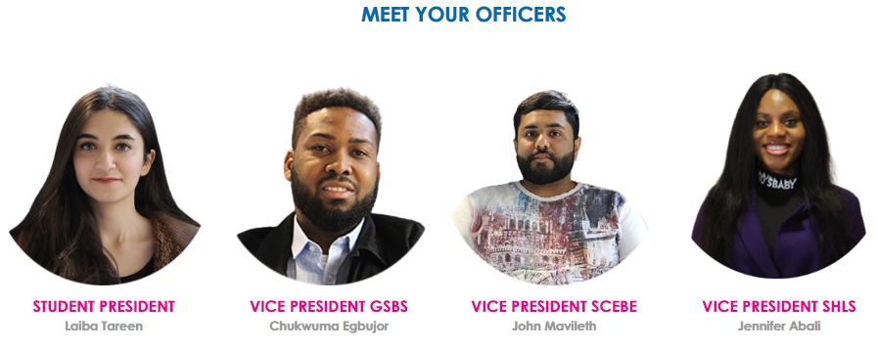
Student - Led
+
Student Voice
Notes:
Universities are required to have Students’ Associations by law (Education Act 1994) with Officers elected in fair and democratic election.

Slide 9
How the Students’ Association Operates

Slide 10
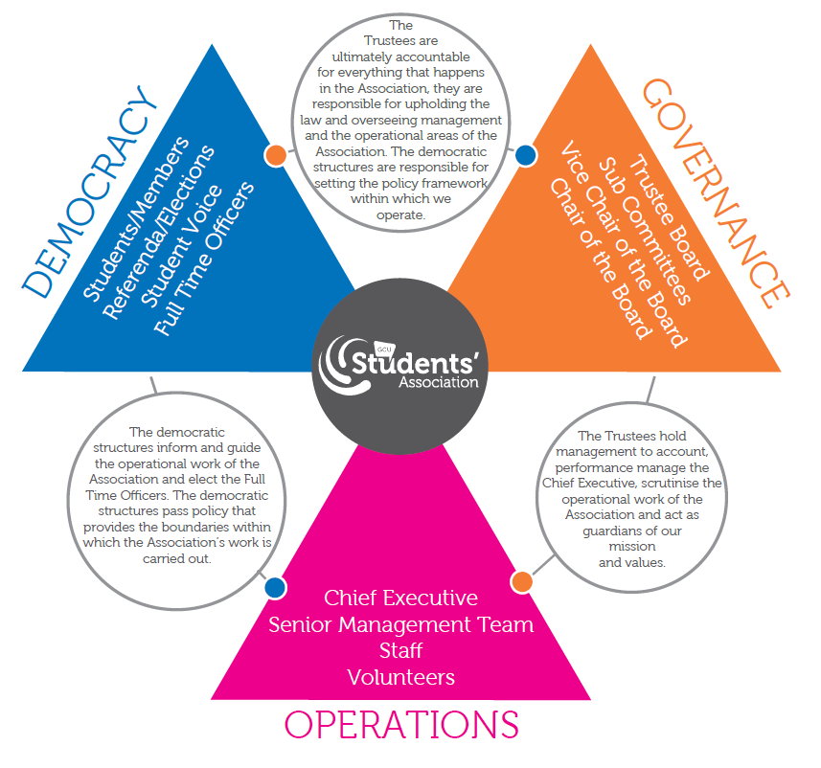
Governance, Democracy and Operations
GCU Students’ Association is split into 3 different areas – Democracy, Operations and Governance.
Each part plays a different role in our decision making.

Slide 11
Students’ Association Governance Structure
Trustee Board
Health & Safety Committee
Appointments Committee
Academic Rep Events
Student Voice
Ideas
Referenda
Class Reps
Dept. Reps, PGT/PGR Reps
SAGE
(Education Committee)
Equality and Diversity Committee
Ethical and Environmental Committee
Executive Committee
Radio Caley Committee
The Edit Committee
Liberation and Representation Groups
Discipline Committee
Freshers
Committee
Sports Council
Trustee Board Decision Making
Representative Decision Making
Responsible to (in direction of arrow)
Societies Council
Student Feedback
Membership Decision Making
Formal decisions & recommendations
Activities Decision Making
Operational Committees
Informal decisions & recommendations

Slide 12
Departments
Representation and Advice Department | Membership Support Department | Activities Department
Representation Campaigning National Union of Students (NUS) Academic Representation Student Voice Advice Centre Wellbeing Events and Workshops Glasgow Students’ Nightline Ethical and Environmental activities | Welcome Desk Finance Office Clerk meetings/supports governance Sales Supports the functions of the Representation and Advice Department and the Activities Department. | Sports Societies Student Leaders Programme Freshers Week Radio Caley (radio station) The Edit (student magazine) Communications Sponsorship and Advertising (Native) Give it a Go (external funded)
Notes:
Explain that the Students’ Association is split into three different departments and briefly explain what each department does.

Slide 13
About Us
https://youtu.be/MJVpWTF8qi0
Notes:
Talk through the Students’ Association Building – what services and facilities

Slide 14
Relationship with Glasgow Caledonian University
Partnership Approach
GCU Student Partnership Agreement
Main Funder
Code of Practice (Education Act)
Financial Memorandum & Licence Agreement
Campuses (Glasgow, London and New York)
Partner Colleges (Bangladesh, Mauritius, Oman)
Representation Structure (Glasgow and London)
GCU Academic Schools (GSBS, SHLS, SCEBE)
Support Departments
GCU Strategy 2030
Enhancement-led Institutional Review (ELIR)
Outcome Agreement
Notes:
Working in partnership
Guide for Members of Higher Education Governing Bodies: Supplementary guide regarding the role of university governing bodies in relation to students’ unions.
GCU University Court audit undertaken.

Slide 15
Who we serve and data on how we are doing

Slide 16
NSS Q26 -The Students’ Union Question
“The Students’ Union (Association or Guild) effectively represents students’ academic interests’.
Notes:
On Question 26 (The Students’ Union/Association question) we had an approval rating of 52%. This is 1% lower than we were last year. We are also lower than the UK wide average of 53% but higher than the Scottish average of 51%

Slide 17
Annual Survey 2021

Slide 18
Members
Headcount = 17,540 (2019/20)
Widening participation (first in family, deprived backgrounds, Recognition of Prior Learning)
Articulation and Pathway Students (direct entry or GCU student whilst at college)
Graduate Apprenticeship students (working and studying at the same time)

Slide 19
NSS Q26 – Subject Segmentation
% agree on Q26 - Subject level (tab 20) | 2022 | 2021 | 2020 | Change
Subjects allied to medicine | 54.48 | 56.31 | 58.98 | -4.5
Business & management | 56.67 | 55.14 | 64.24 | -7.57
Computing | 44.62 | 46.43 | 46.71 | -2.09
Engineering & technology | 45.5 | 46.43 | 47.14 | -1.64
Building, planning & architecture | 33.79 | 39.71 | 49.64 | -15.85
Creative arts & design | 59.69 | 50 | 50 | 9.69
Social sciences | 57.45 | 56.04 | 58.3 | -0.85
media, journalism and communications | 41.67 | 48.33 | 44.68 | -3.01
Psychology | 50 | 70.49 | 61.43 | -11.43
Law | 53.23 | 48.84 | 65.22 | -11.99
Notes:
For the two largest subject areas at GCU, allied health and business & administration studies, there is an increase in satisfaction. Allied health increased by 1.8% while there was a significant increase of 4.5% for business & admin studies. Moreover, engineering and computer science, who together account for 18% of the NSS respondents and make up the bulk of the School of Computing, Engineering and Built Environment (SCEBE) programmes, also experienced significant increases with computing science increasing by 6.5% and engineering by 2%. However, the subject areas of social studies, biological sciences, and building & planning had significant decreases in satisfaction as well as still being over 5% of NSS respondents. Most notably, biological sciences satisfaction with academic representation decreased to under 16% and building & planning by 11%.

Slide 20
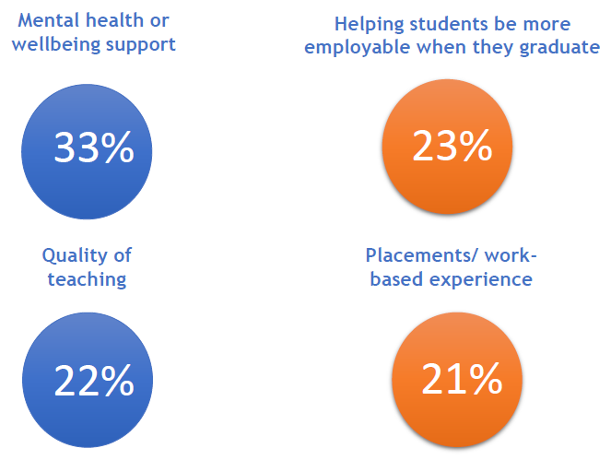
What students want us to focus on
GCU Top 5
Mental health or wellbeing support (29%)
Placements/ work-based experience (23%)
Employability (21%)
Quality of teaching (20%)
One-to-one academic support (18%)
Notes:
This is from the 2018/19 research that we commissioned from Alterline –
73% of students choose at least one of these things from a list of 27 as being amongst the three most important which students’ unions (associations or guilds) can provide to represent their academic interests. Mental health and wellbeing support was chosen by the most.
The covid question correlations with Q26 validates that it is mental health and teaching and learning quality. (There was no questions on employability)

Slide 21
Aspects of university life which students are the least satisfied with include
financial situation
anxiety over career
wellbeing

Slide 22
Bonus Data on GCU Students
Student numbers by type of degree and where domiciled: https://public.tableau.com/views/StudentproviderHESA2023/Dashboard1?:language=en-GB&:embed=y&:embed_code_version=3&:loadOrderID=4&:display_count=y&publish=yes&:origin=viz_share_link
Type of accommodation
https://public.tableau.com/views/Book7_16751892482780/Dashboard1?:language=en-GB&:embed=y&:embed_code_version=3&:loadOrderID=3&:display_count=y&:origin=viz_share_link

