Slide 1
Candidates Campaign Training

Slide 2
Today we will cover
Top campaigning tips
Things to do before elections week
Manifesto Writing
Campaign Planning
What to do during the week
Campaigning Techniques

Slide 3
Congratulations for putting yourself forward!
DISCLAIMERS
This does not guarantee you’ll win!
We will not answer any questions about rules
This is only advice, you can use it as you wish

Slide 4
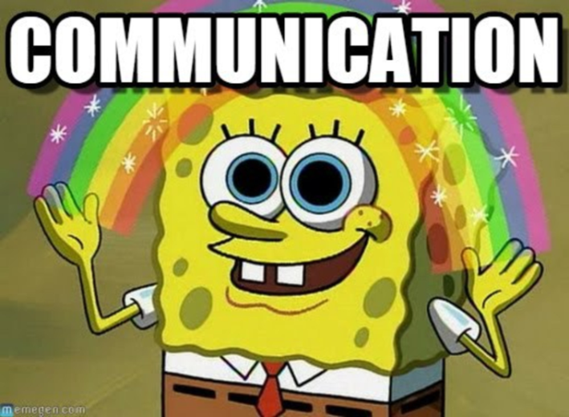
What is your message?
The best candidates have a clear, consistent message
What’s your ‘brand?’
Proofread!
Manifesto
SMART Targets
Clear and easy to read
Think of what you want to achieve

Slide 5
Get your team together
What’s the purpose of the team?
Get you pumped
Be a sounding board
Support you through the week (and results)
A point of contact for DRO during the week
NB You are responsible for your team
Make sure they know the rules
Say thank you!

Slide 6
Campaign video
The EDIT will be providing opportunities to film videos
But you can always do one yourself
Teaser Video
Talking Head
Short Manifesto Video
Parody
Input vs. Output

Slide 7
Before the week…
Meal prep!
Make arrangements for anything you might miss
Plan your week
When are you going to be on campus?
What lectures are you hitting?
Are you going round halls?
Are you campaigning in the evenings?

Slide 8
Promoting yourself
Be creative!
How can you get your message out?
Social Media
How can you stand out?
Facebook, Twitter, Instagram, Myspace
Flyers and posters
Important to have but they don’t win elections!
Make them distinctive

Slide 9
Public Speaking
Preparation is key
Who? How long? Why? What?
Notes vs. Script
Know your topic
Think about non-verbal communication

Slide 10
What is Campaigning?
Campaigning is simply communicating to as many people as possible and showing them why they should vote for you
Campaigning = votes

Slide 11
Why do people vote?
Were asked directly
Knew what the candidate stood for
Had seen a poster or flyer
Had read the manifestos
Had read the union’s publicity
72%
60%
70%
29%
4%

Slide 12
Campaigning
You have 100 hours to get elected
Examples include:
Lecture Shouts
Flyering
Door knocking
Always ask permission, be relevant, and quick
1-on-1 campaigning
Social Media (videos, posts, pictures)
Something else entirely…

Slide 13
Talk that talk
Know what you want to say
Get your pitch down to 30 seconds
Tailor it to your audience
Talk to everyone
Remember to get 2nd preferences votes!
Talk to others like you’d like to be talked to

Slide 14
Let’s give it a go!
There are GCU staff members on the second floor.
You have 2 minutes to prepare your pitch/points
They are students – go and try to talk to as many of them as you can and persuade them to vote.

Slide 15
Reflect
How did you find that?
What was difficult?
How did you react to the different situations?

Slide 16
During the week
Use your time wisely
Follow the rules
If you’re not sure about anything, ask DRO
Hope for the best, prepare for the worst
Regardless what happens, you should be proud
Focus on your campaign – not others

Slide 17
Look after yourself
It’s okay to take time off
SLEEP
Eat properly
Try not to get caught up in #Drama
Keep your head up!
Candidates Breakfast – every morning

Slide 18
Questions?

